Slide 1
Financial analytics
By Group 4.

Slide 2
Year wise loan amount stats
Year wise loan amount statistics represent the growth of the loan amount from year 2007 to 2011.
The graph shows the amount of loan and gradual increase over the years.
Year 2011 has 58.46% share in the total amount of the loan with year 2007 having the lowest amount being 0.5%.

Slide 3
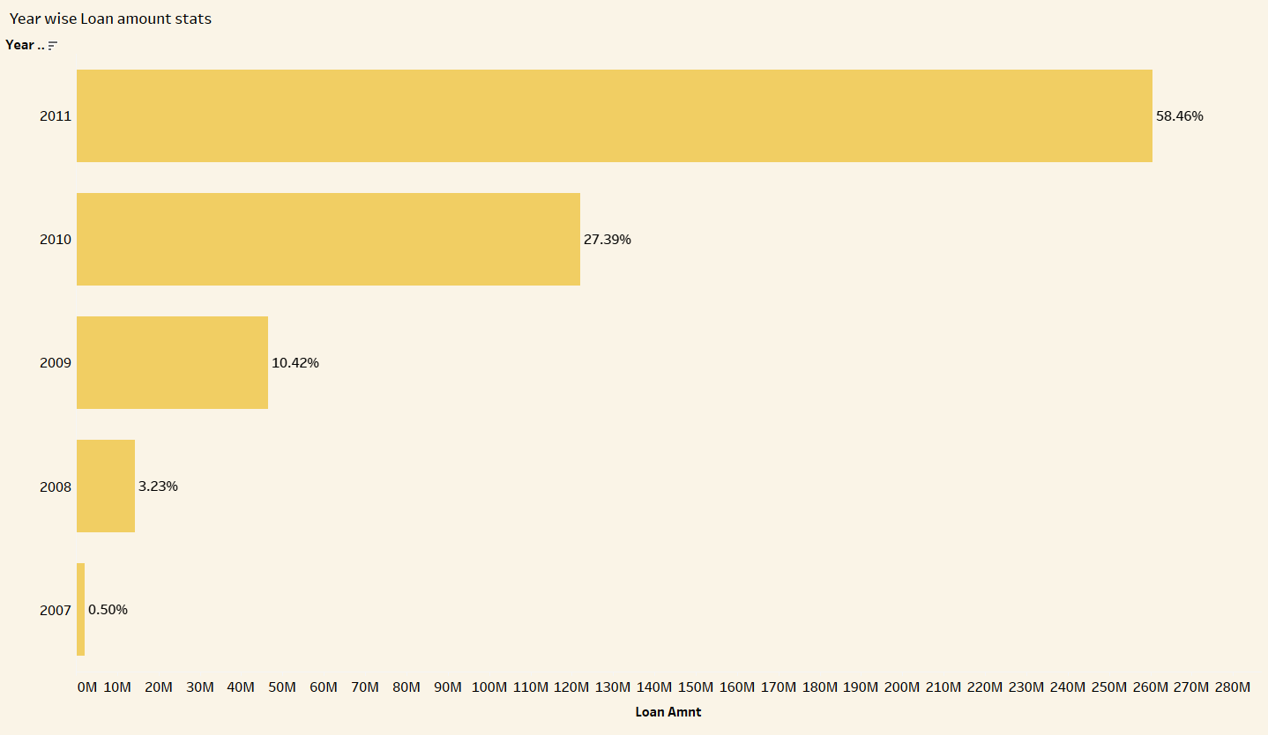

Slide 4
Grade and Subgrade Revolving balance
This KPI represents the revolving balance of the Loans according to their grades and subgrades.
Revolving balance of E,F and G are considerably lower than A, B, C and D.
The highest of them being in sub grade 3 of grade B with 7.47% and the lowest being sub grade 5 in grade G with 0.13%.

Slide 5
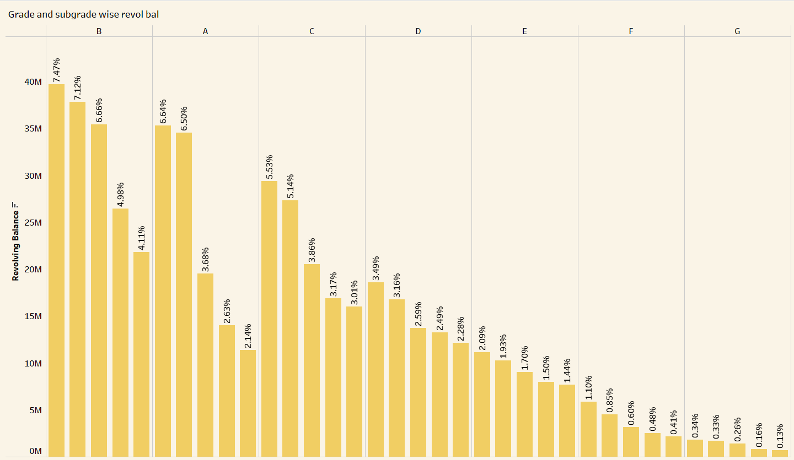

Slide 6
Total payment verified vs non verified.
This KPI is for comparison between the total payment of verified loans and total payment of non verified loans.
The payments of verified loans are more than double than that of non verified loans.
Out of total payments verified loans have 68.19% share as compared to 31.61% of non verified loans.

Slide 7
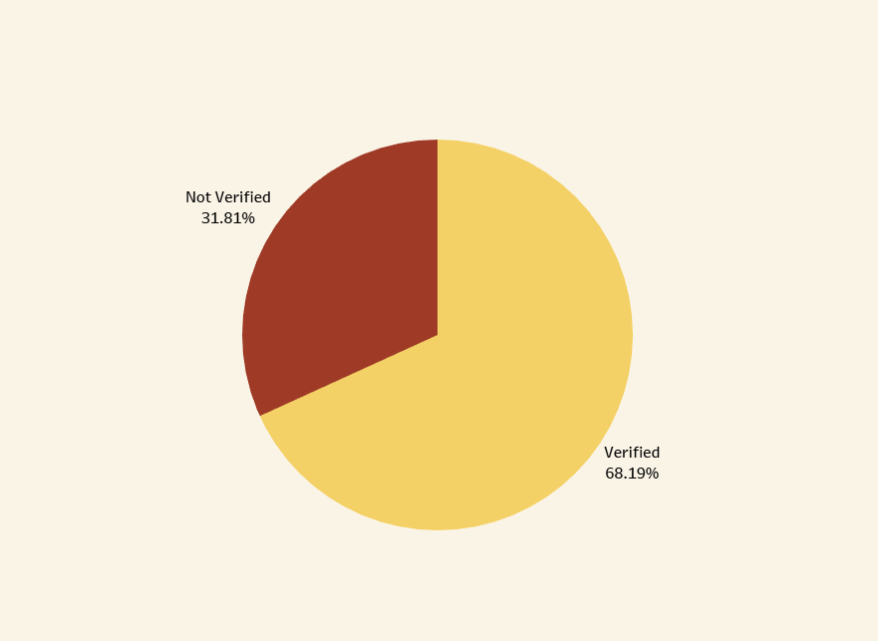

Slide 8
State wise loan statistics
This KPI provides us the information about the loan status of all the states.
California is the leading state in terms of all the loans that are charged off, currently ongoing and paid off. The state has 17.87% loans being the leading state with loans.
New York and Florida also have sizeable loans with 9.6% and 7.22% respectively.
While Maine and Iowa are the states with lowest percentage of all the loans with 0.01% each.

Slide 9
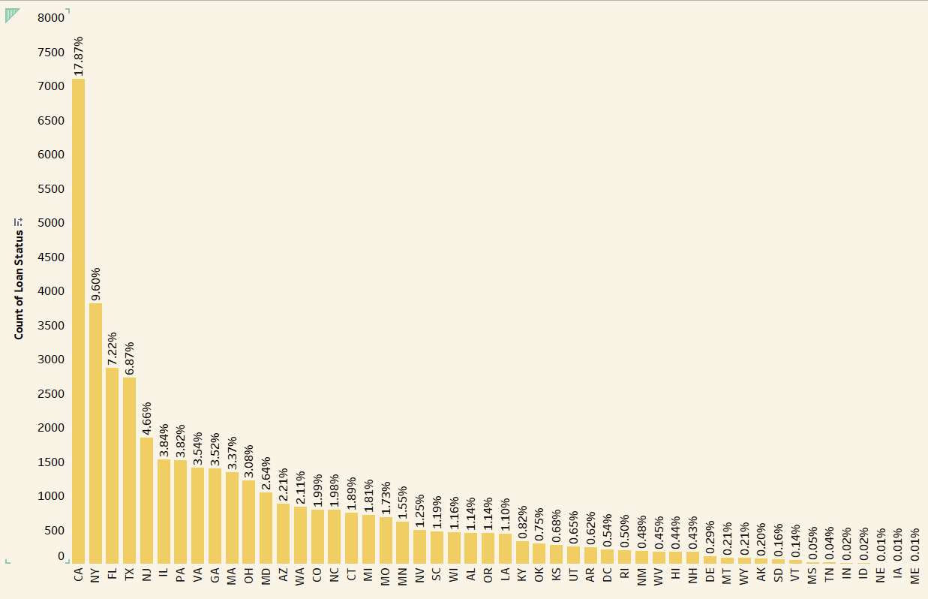

Slide 10
Home ownership vs Last payment date
This KPI provides the insight into the payments on different types of home loans such as mortgage, ownership and rent over the different years.
We can see the steady increase from year 2010 in all types of home loans and the decrease in the same after year 2014.
Mortgage loans have a huge share in the home loans while rent loans have the least share with ownership loans being in the middle.

Slide 11
